Slide 1


great springs
P R O J E C T
FROM THE ALAMO TO THE CAPITOL
A Legacy Project For All of Texas
Garry Merritt Kenny Skrobanek
CEO Trails & Transportation Planner
garry@greatspringsproject.org Kenny@greatspringsproject.org
(210) 260-9839 (512) 337-3850

Slide 2
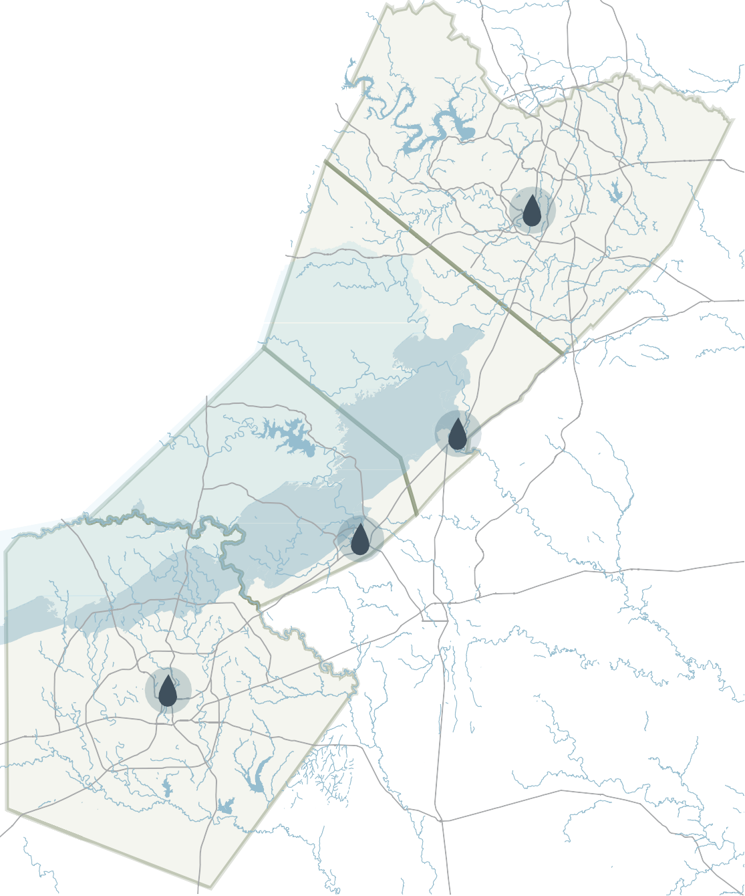
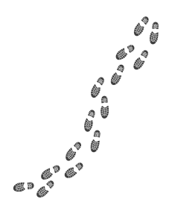




great springs
P R O J E C T
Mission: Connecting Four Great Springs
A national park-sized corridor of protected lands between San Antonio and Austin over the Edwards Aquifer recharge and contributing zones.
A 100-mile spring-to-spring trail network from the Alamo to the Capitol.
50,000 acres of additional protected lands over the recharge zone between San Antonio and Austin.
Barton Springs
“Connecting our Communities;
Protecting our Springs”
San Marcos Springs
Comal Springs
San Antonio Springs

Slide 3
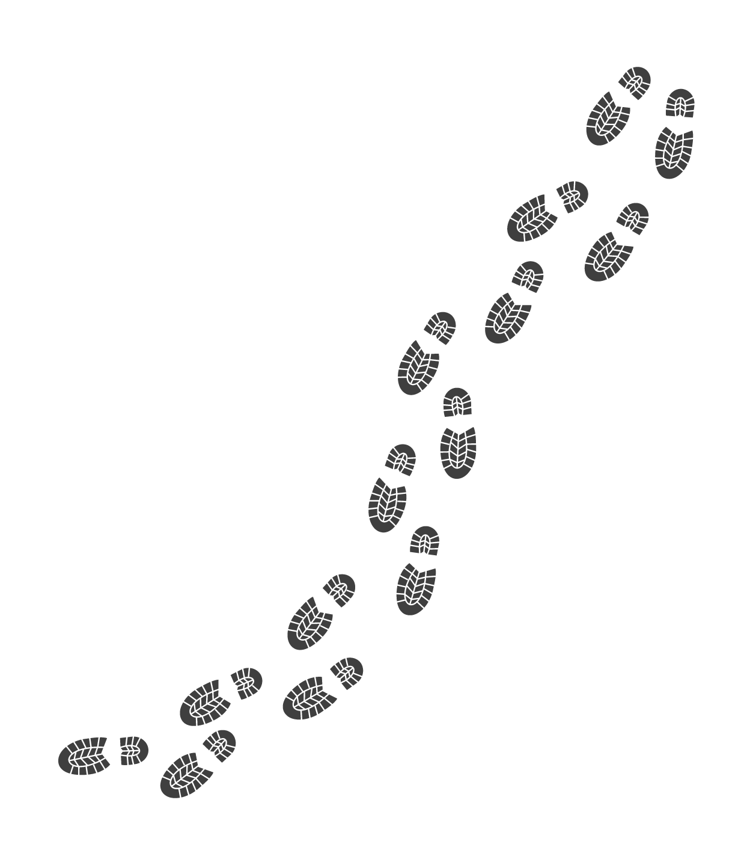

great springs
P R O J E C T
An ancient story in a modern context
The estimated 4,000-year-old White Shaman mural in southwest Texas depicts a string of four symbols which some believe may be the four major springs along the Balcones Fault.
Barton Springs
San Marcos Springs
Comal Springs
San Antonio Springs

Slide 4
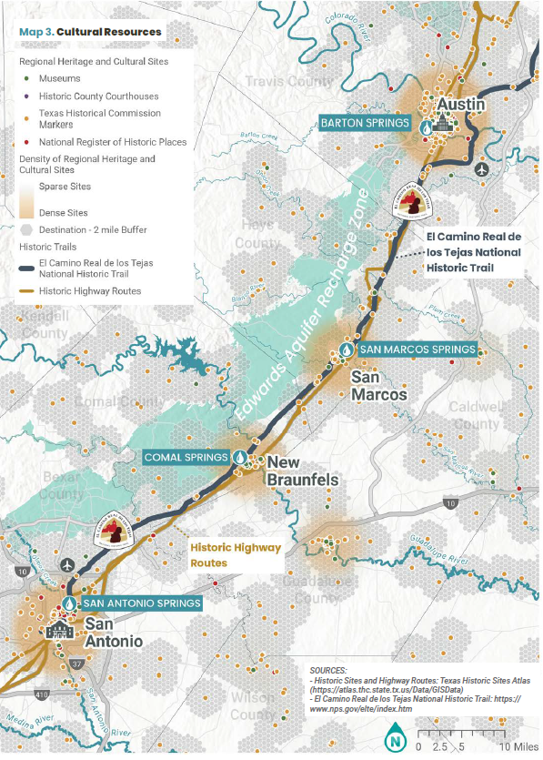
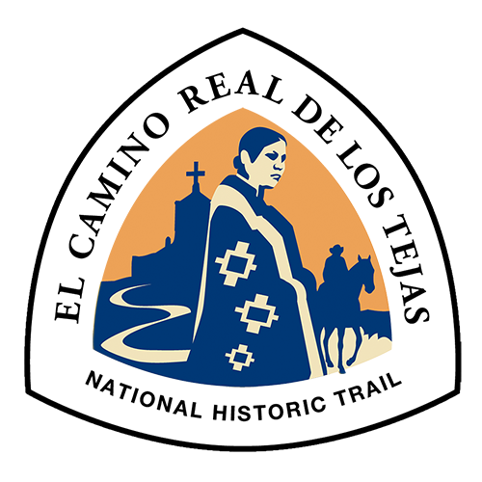
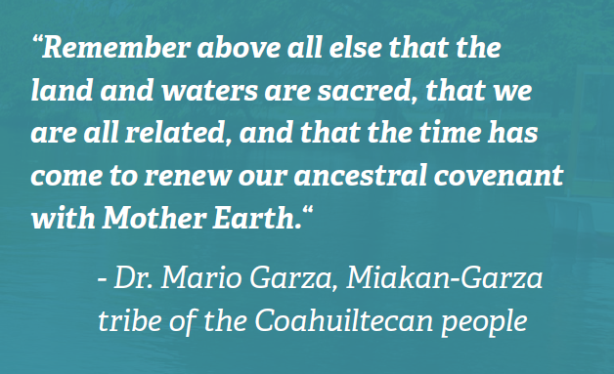
great springs
P R O J E C T
To Preserve Our Heritage
Connecting the region’s share heritage
El Camino Real de los Tejas stretches from Mexico to Louisiana traversing through Texas including along Great Springs Project conservation corridor.

Slide 5
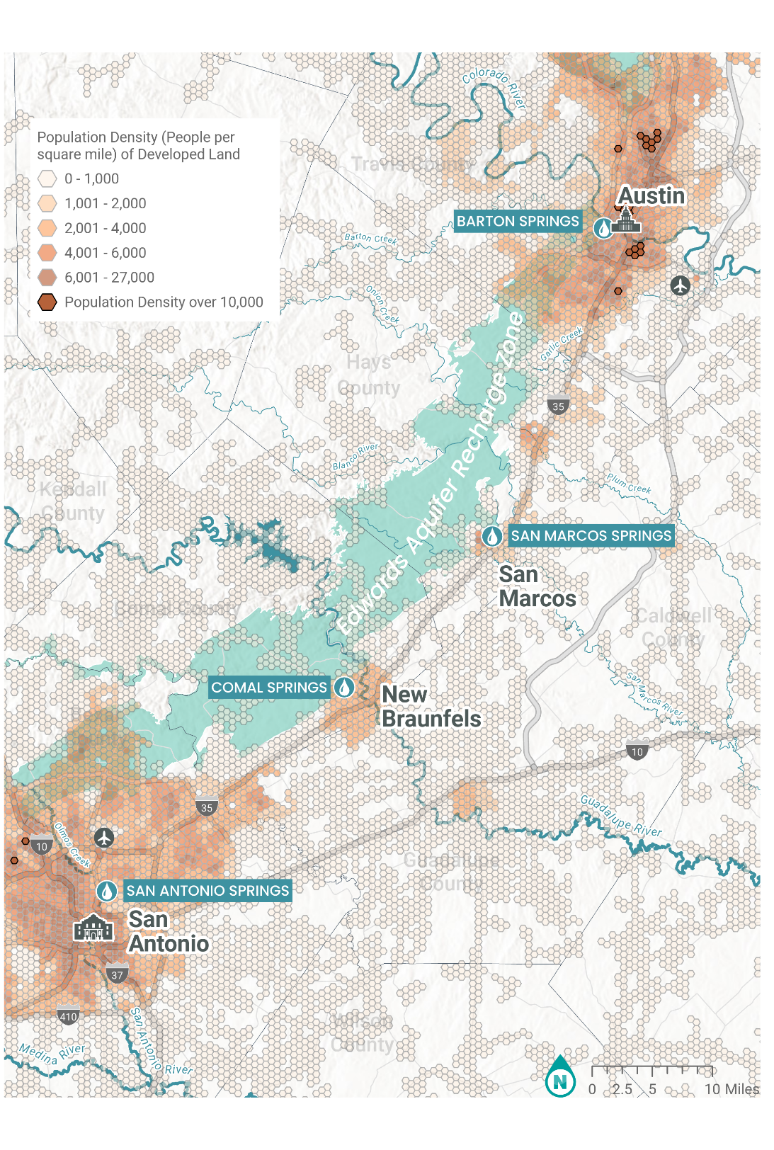
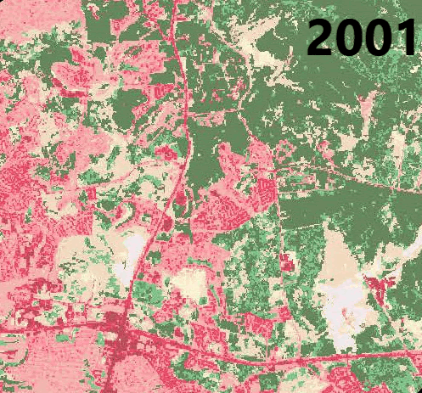
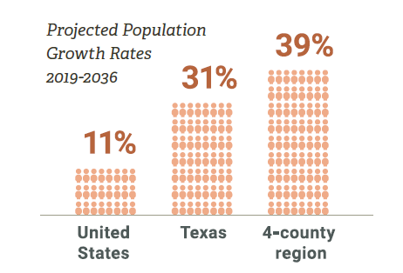
great springs
P R O J E C T
To Protect Our Resources
Blazing a Trail in a Fast-Growing Region
Central Texas is transforming into a mega-region.
This growth presents many challenges:
  Strain on natural resources, such as water supply
  Strain on built infrastructure, such as transportation and utilities
  Loss of open spaces for wildlife, aquifer recharge, and flood protection

Slide 6
great springs
P R O J E C T
Protecting the Edwards Aquifer Recharge Zone
GSP’s goal is to help protect an additional 50,000 acres of land in the Recharge Zone of the Edwards Aquifer, one of the most productive aquifers in the United States.1
This corridor is characterized by the presence of sinkholes, sinking streams, caves, large springs, and highly productive water wells. Local and regional organizations throughout the Hill Country have been working for decades to protect the region’s land and water supplies.
GSP’s conservation goal will be achieved through conservation partnerships and direct communication with landowners, developers, and local governments. The 100-mile trail network from the Alamo to the Capitol connects communities and increases awareness of the importance of the Edwards Aquifer and the protection of the iconic springs that flow from it.

Slide 7
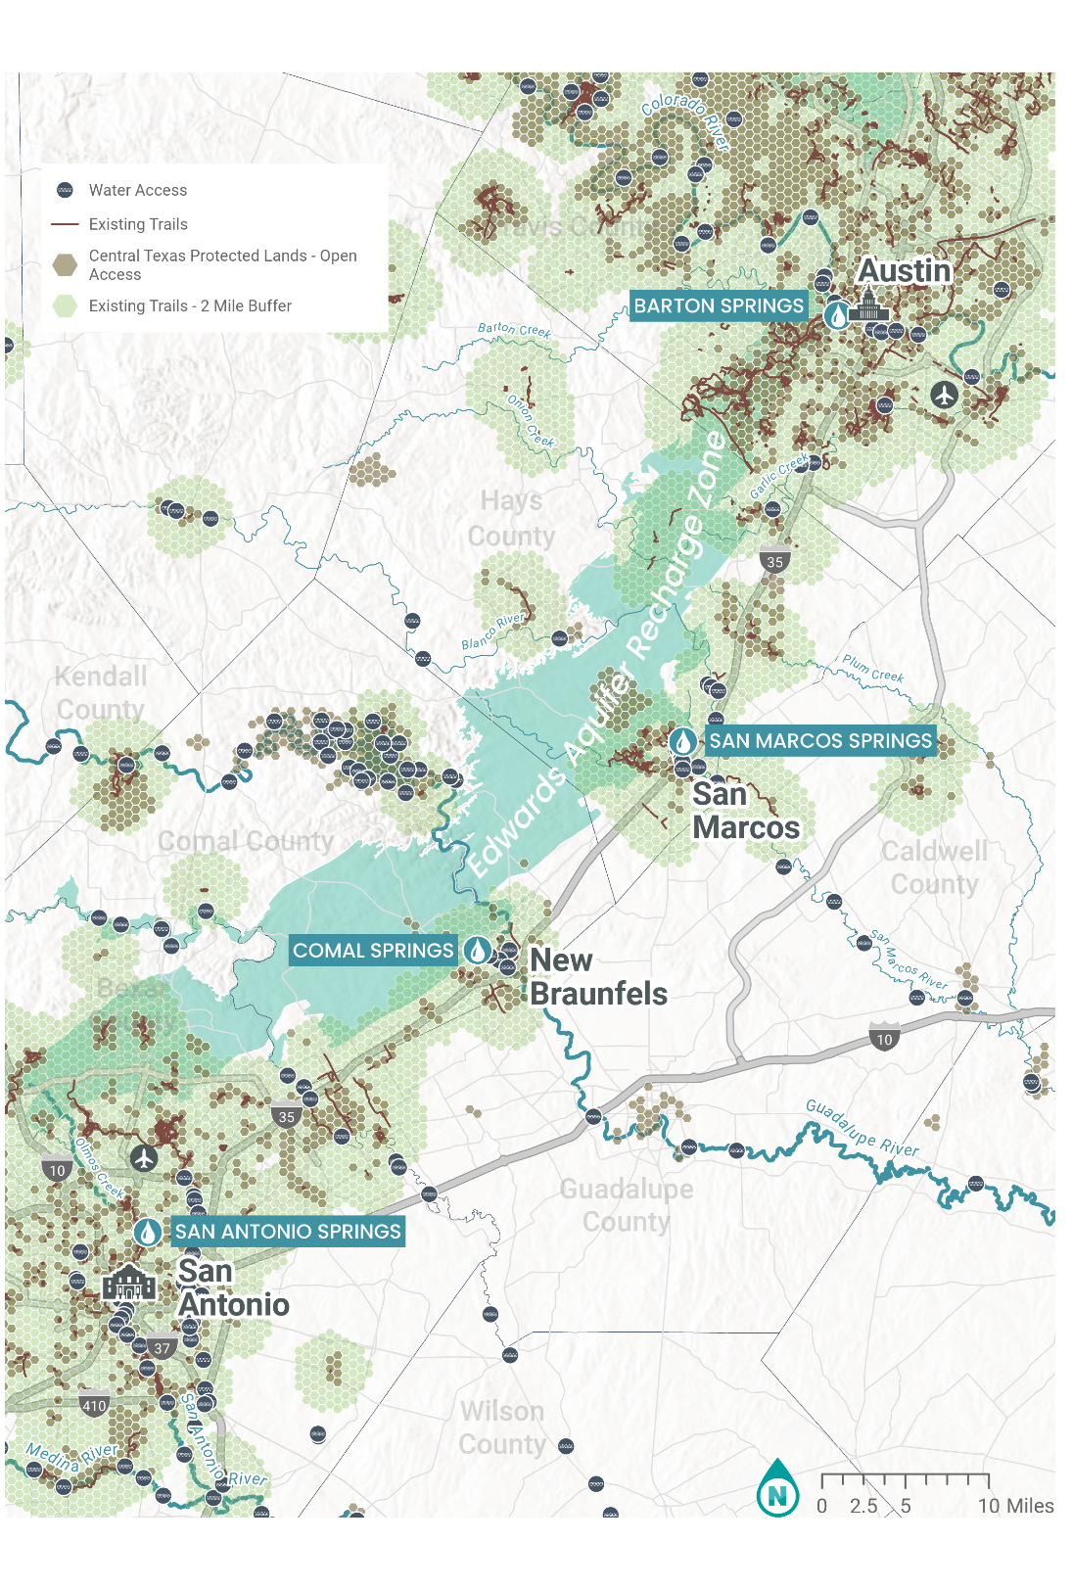
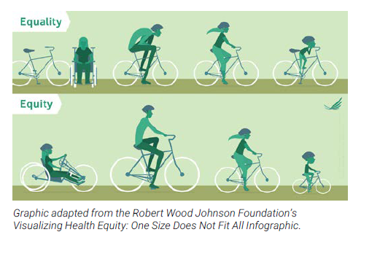
great springs
P R O J E C T
To Connect Our Community
Providing Access to the Outdoors for All
Today, less than 4 percent of land in Texas is accessible to the public.
The shortage of access to open space is magnified in rapidly developing Central Texas.
However, there are new opportunities that come along with a growing population – increased appetite for high quality public space opportunities and funding through public sources.

Slide 8
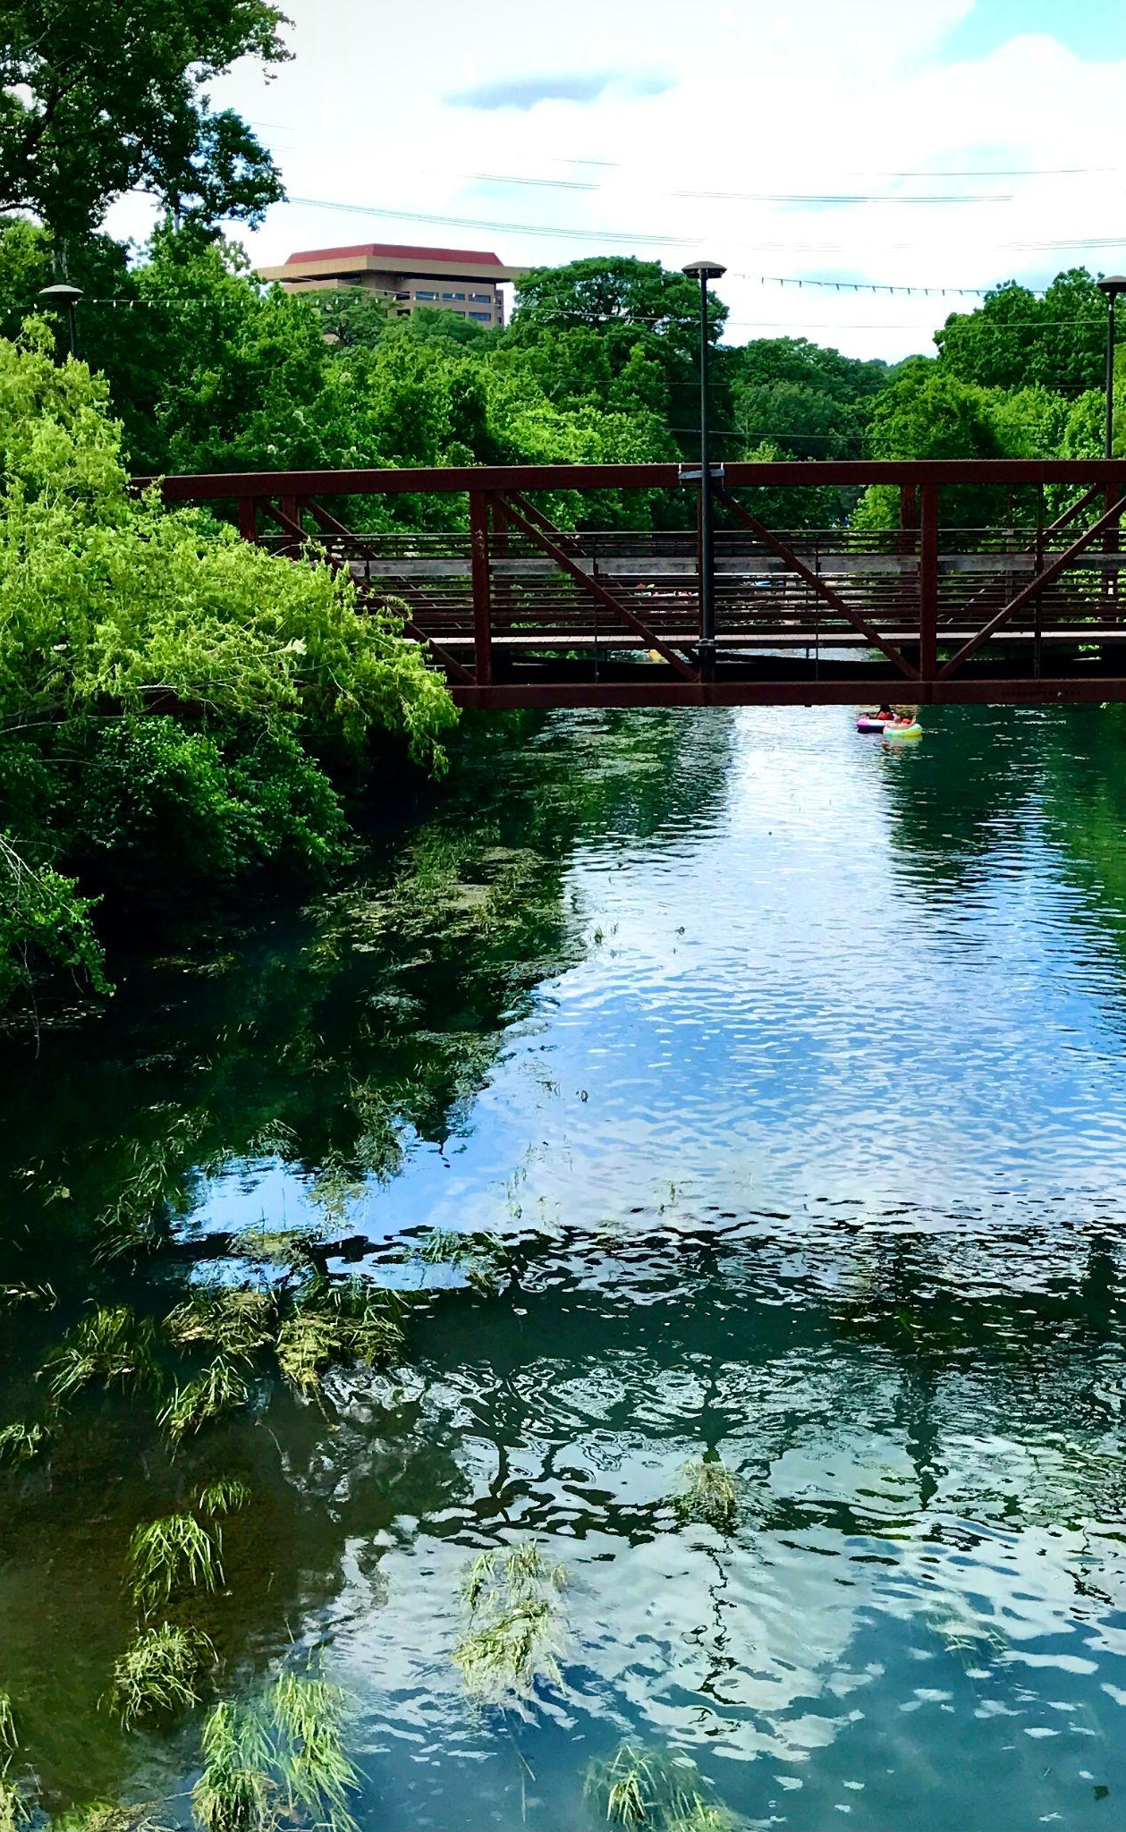
great springs
P R O J E C T
Equity Task Force
To ensure our work provides access to nature for all people of all abilities
“GSP’s mission to protect and connect Texas’ beautiful natural surroundings is underpinned by the fundamental requirement of equity and inclusion in public access to this beauty.”
- Equity Task Force
Melissa Ayala, Waterloo Greenway
Monica Borrego, New Braunfels Food Bank
David Buggs, Texas Parks and Wildlife Department
Mariana Espinoza, City of Kyle
Arnold Garcia (late), Former Editorial Page Editor, Austin American Statesman
Dr. Ana Gonzalez, City of Austin
Angelica Holmes, Black Outside, Inc.
Jeanette Honermann, REI, Inc.
Reverend Addae Kraba, Unitarian Universalists of New Braunfels
Pablo Montes, Indigenous Cultures Institute
Maria Rocha, Indigenous Cultures Institute
Sister Cindy Stacy, Headwaters at Incarnate Word
Dr. Marla Torrado, Community Powered Workshop
Joshua Tuck, National Park Service
Rocío Villalobos, City of Austin
Dr. Skyller Walkes, University of Texas

Slide 9
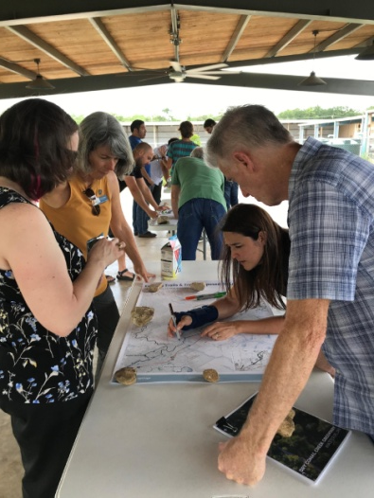
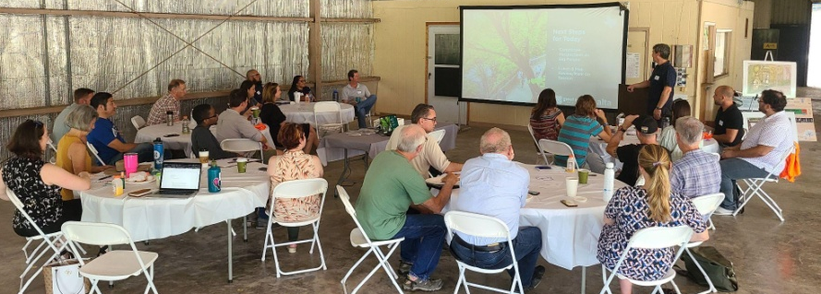
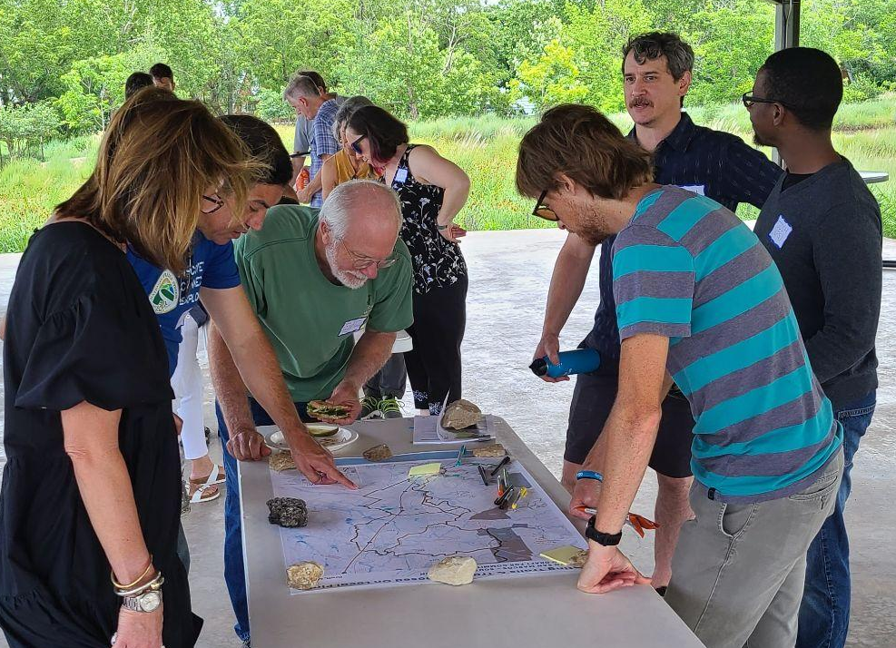
great springs
P R O J E C T
Trails Development Steering Committee
Jim Bailey, ActivateSA
Sherwood Bishop, San Marcos Greenbelt Alliance
Ylda Capriccioso, City of New Braunfels Parks and Recreation
Jamie Lee Case, City of San Marcos Parks and Recreation
George Cofer, Hill Country Conservancy
Janet Coles, Travis County Parks
Mariana Espinoza, Kyle Parks and Recreation
Steven Gonzales, El Camino Real de los Tejas National Historic Trail
Steve Graham, San Antonio River Authority
Aaron Mahr, National Park Service - National Trails
Nancy Pappas, Headwaters at the Comal
Nathan Pence, Guadalupe-Blanco River Authority
Margo Richards, Lower Colorado River Authority
Maria Rocha, Indigenous Cultures Institute
Brandon Ross, City of San Antonio Parks and Recreation
Tony Canez, Bexar County
Lauren Shrum, City of Schertz Parks and Recreation
Tyler Frost, City of Buda
Butch Smith, Hill Country Conservancy
Robin Stallings, Bike Texas
Mark Taylor, Emerald Crown Regional Trail Work Group
Alexandra Thompson, Hays County Natural Resources
Joshua Tuck, National Park Service
Katie Wettick, City of Austin Public Works

Slide 10
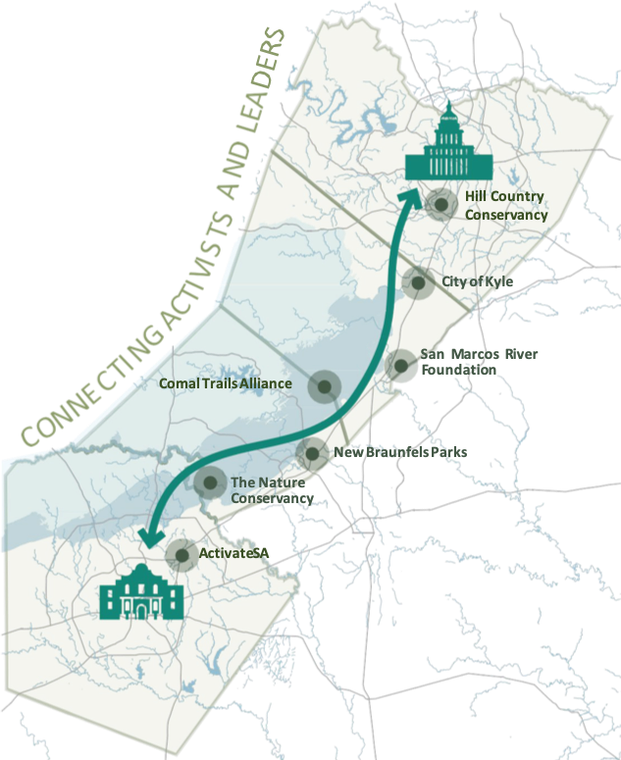

great springs
P R O J E C T
Land & Trail Partners
Connecting community leaders, stakeholders and interest groups throughout the corridor:
Audubon Texas
Austin Outside
Budaful Hiker
Camp Bullis Sentinel Landscape
City of San Marcos,
City of Kyle
City of Buda
Hays County
City of New Braunfels
City of Schertz
Comal County
City of San Antonio
City of Austin
Bexar County
Colorado River Alliance
Colorado River land Trust
Comal County Conservation Association
Comal Trails Alliance
Conservation Fund
Green Spaces Alliance
Guadalupe Blanco River Authority
Guadalupe Blanco River Trust
Headwaters at the Comal
Hill Country Alliance
Hill Country Conservancy
Hill Country Land Trust
Lower Colorado River Authority
Meadows Center for Water and the Environment at Texas State University
San Antonio River Authority
San Marcos Greenbelt Alliance
San Marcos River Foundation
Shoal Creek Conservancy
Texas Land Conservancy
Texas Water Foundation
Texas Water Trade
Texas Wildlife Association
The Nature Conservancy
Travis Audubon
Travis County Parks
Trust for Public Land
Wimberley Valley Water Association

Slide 11
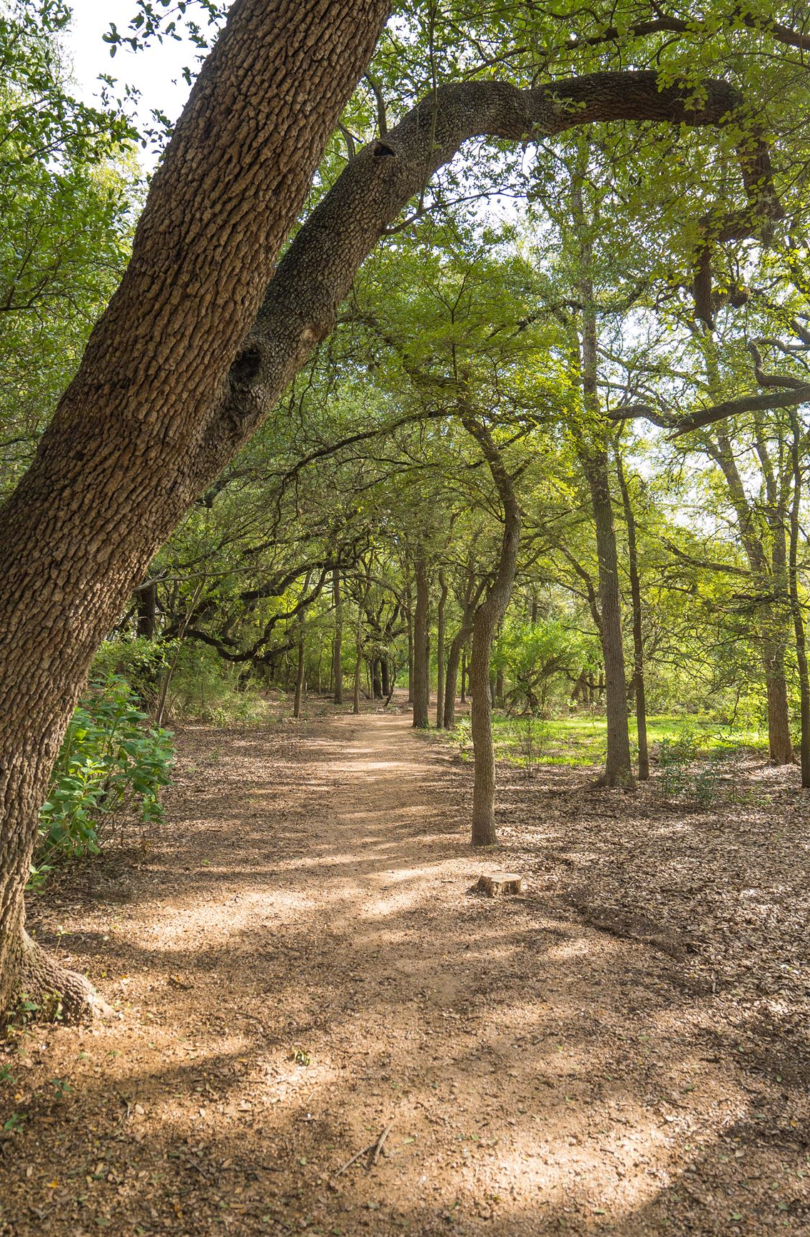
great springs
P R O J E C T
Our Team
Board
Advisory Board
Deborah Morin, Chair
April Ancira
Hope Andrade
Tom Bacon
Kyndel Bennett
Cindy Matula
Andy Sansom
Dianne Wassenich
Anne Ashmun
Ray Brimble
Mike Burke
Ted Flato
Bill Johnson
Phil Hardberger
John Mackey
Les Shephard
Lee Walker
Bill West
Senior Staff
Garry Merritt, CEO
Lyda Creus Molanphy
Emma Lindrose-Siegel
Bill Barker
Scott Parker
Forest Ridge Park - Schertz

Slide 12
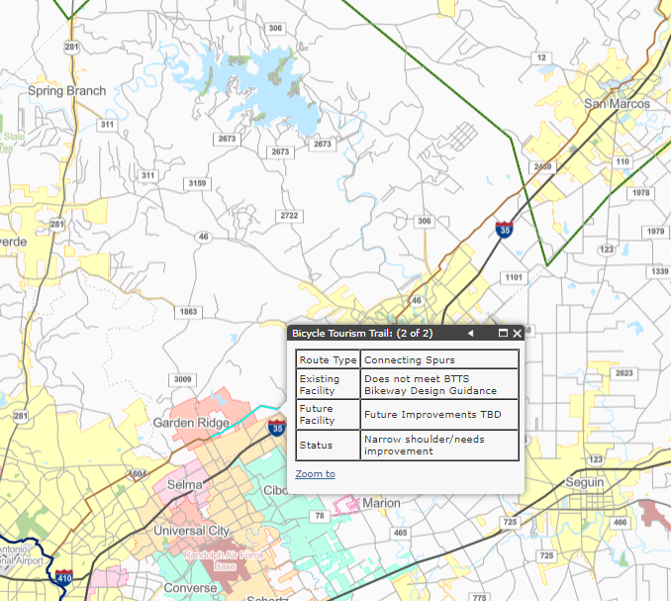
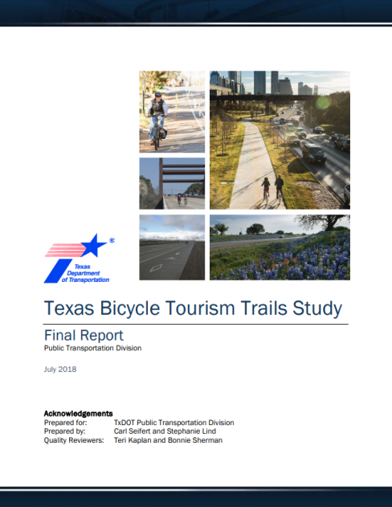
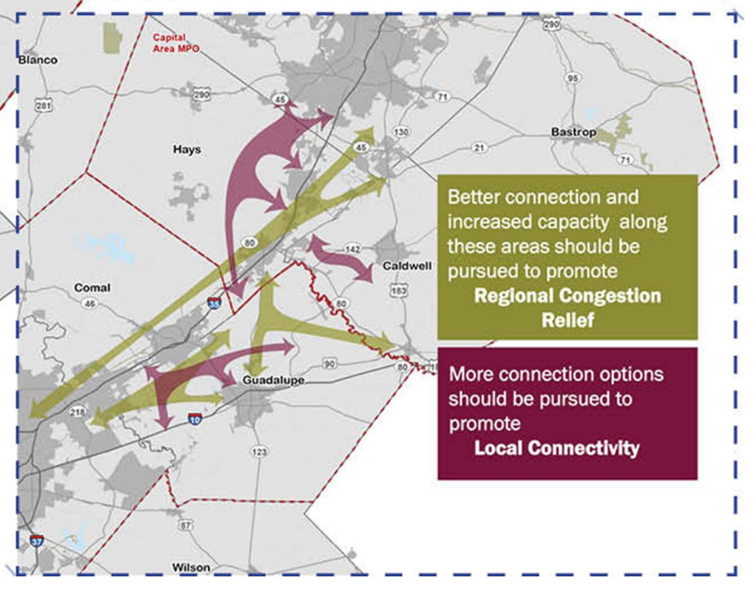
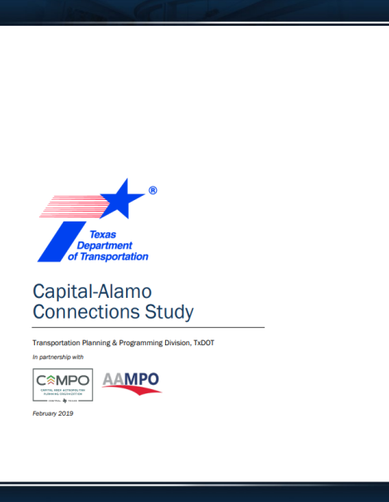
great springs
P R O J E C T
Regional Planning Efforts
2018 Texas Bicycle Tourism Trails Route
A “connecting spur” within the BTTS study runs directly along the Great Springs Project trail corridor.
The TxDOT BTTS route follows City of San Antonio Trails.
Some BTTS existing route sections in TXDOT ROW can be upgraded to meet BTTS Design Guidance.
Advance 2019 Capital-Alamo Connections Study
Part of “Mid Term” Regional Coordination Strategies to be implemented from 2025-2035 calls out action to promote potential interregional bicycle routes and new long distance bikeways:
  Connect regional bicycle networks along highways
  Coordinate regional bicycle routes with transit agencies for connectivity
  Use regional technical partnerships to promote, fund, and construct interregional bikeways
Connections along and through TxDOT ROW can advance this goal.
Making these connections will fulfill the actions set forth in the 2019 Capital-Alamo Connections Study
“Promote potential interregional bicycle routes and new long distance bikeways: Connect regional bicycle networks along highways”

Slide 13
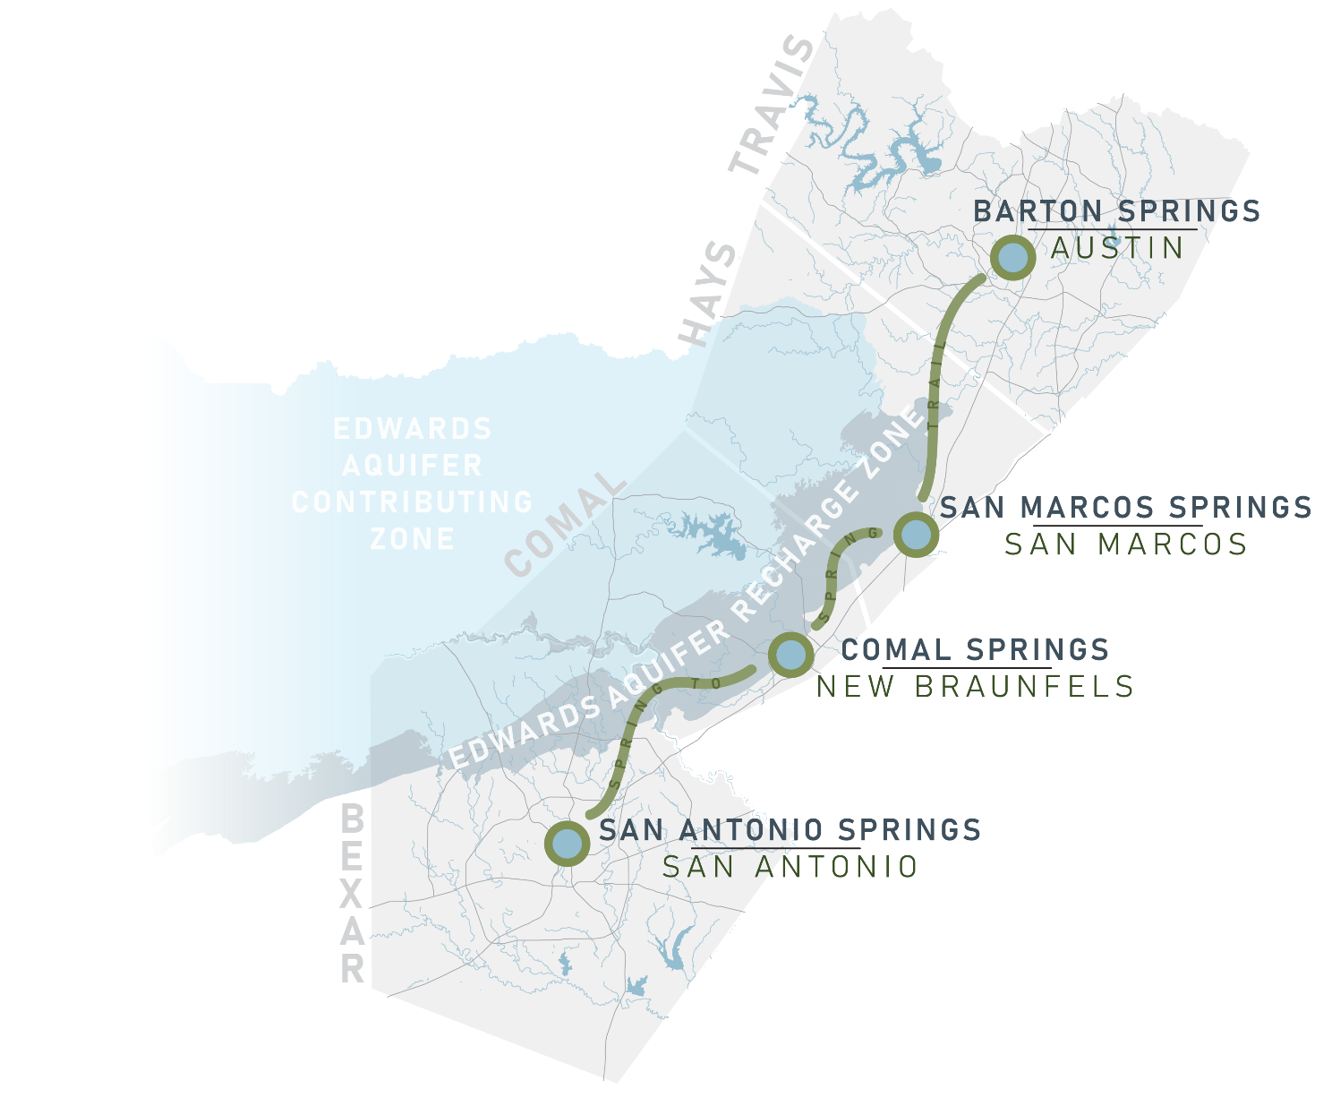

great springs
P R O J E C T
Regional Planning Efforts
In AAMPO’s Mobility 2050 Long Range Plan, Great Springs Project is recognized as a potential partner for IIJA funding to improve interregional mobility.
“With new eligibility requirements, the IIJA is providing a viable path to seeing the Great Springs Project become a reality. The IIJA allows non-profits to apply for grant funding and still maintains program funding for active transportation projects submitted to MPO’s for program funding.”
- Mobility 2050

Slide 14
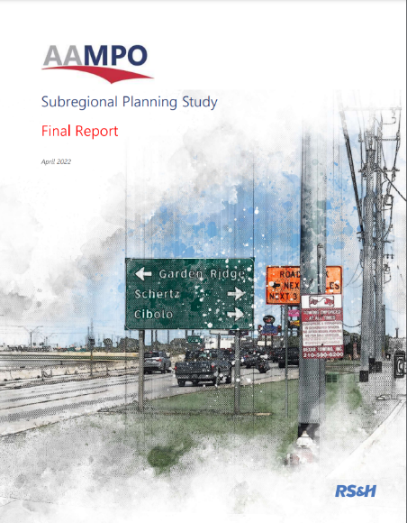
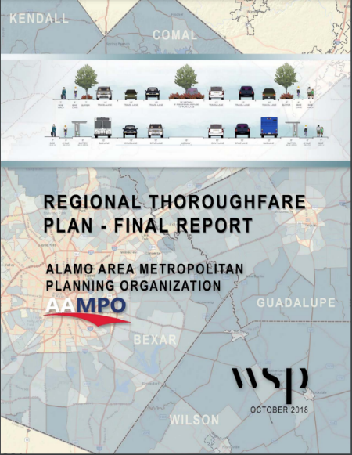

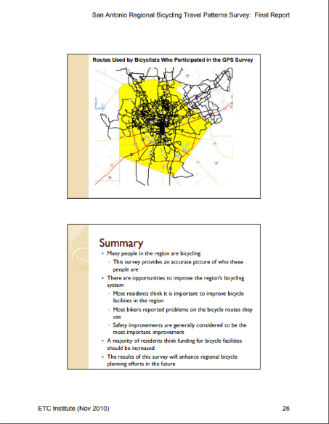
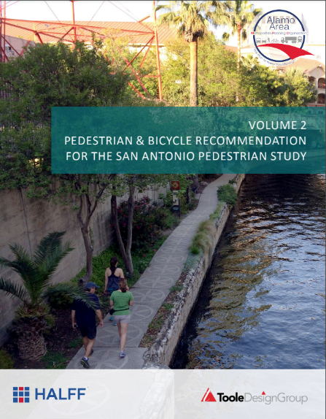
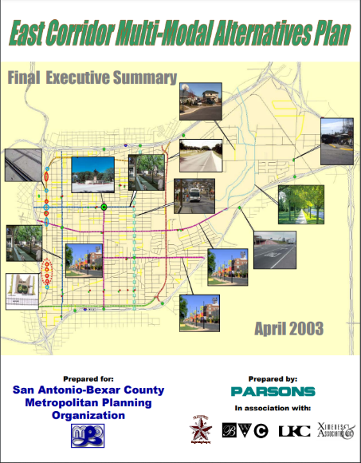
great springs
P R O J E C T
Regional Planning Efforts
Mobility 2050 is not the first AAMPO Plan highlighting key connections
in the Great Springs Project Network:
Subregional Planning Study (April 2022)
Regional Thoroughfare Plan Study (October 2018)
Regional Bicycle & Pedestrian Planning Study (2016)
East Corridor Multi-Modal Alternatives Plan (April 2003)
Bicycle Travel Patterns Survey
Alternatives Analysis of Multimodal Transportation Improvements for Downtown San Antonio (2003)

Slide 15
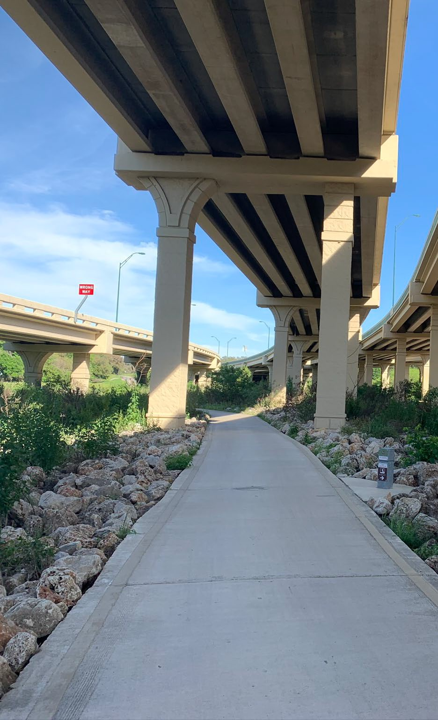
great springs
P R O J E C T
Leveraging Funds
Local Funds
Federal Funds
Parks, Transportation, and Drainage Municipal Bonds
Flood Mitigation
Water quality protection
TWDB Clean Water State Revolving Fund
Habitat Conservation Plans
Edwards Aquifer Authority
Emergency Management Plans
Bipartisan Infrastructure Law
Transportation Alternatives Funding through MPOs
RAISE Discretionary Grants
INFRA Discretionary Grants
Great American Outdoors Act
Land and Water Conservation Funds
30x30/America the Beautiful
State Funds
TXDOT
  Statewide Transportation Alternatives
  Highway Safety Improvement Program
  Traffic Safety General Grants
TWDB for green infrastructure
TDA & GLO for flood mitigation
TDEM for emergency management
TPWD Recreational Trails Grants
Texas Farm and Ranch Lands Conservation Program
Salado Creek Greenway/ Wurzbach Parkway – San Antonio

Slide 16
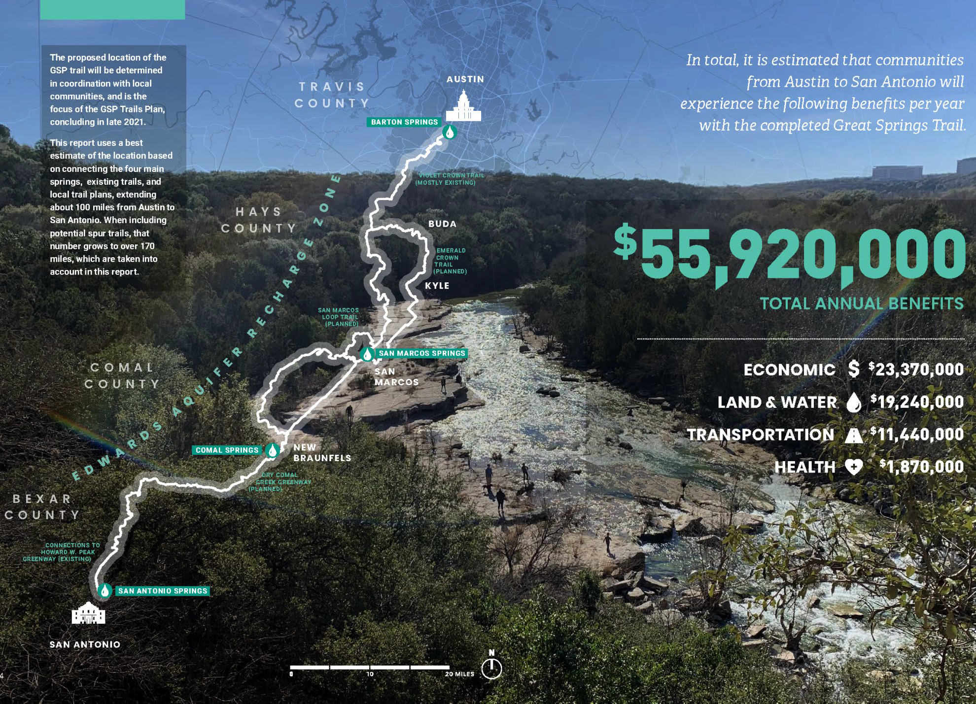
great springs
P R O J E C T
Notes:
This section displays the estimated annual economic benefits of the Great Springs Project by county. Benefits based on land cover (ecosystem and carbon sequestration benefits) used the proportion of land within the study area for each county to apportion benefits. The remaining benefits were allocated to each county based on the proportion of estimated users within each county.
Factors such as flood damage and loss of open space are outlined in other sections of this report in terms of their costs and challenges to the region, rather than in terms of annual benefits.

Slide 17
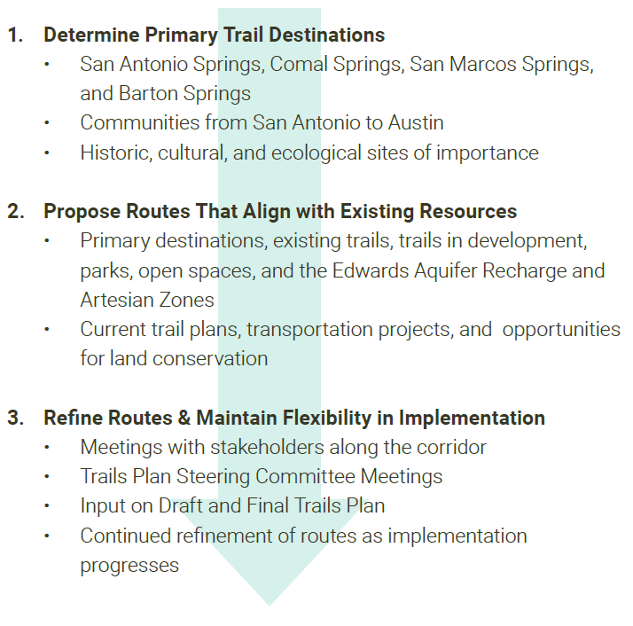
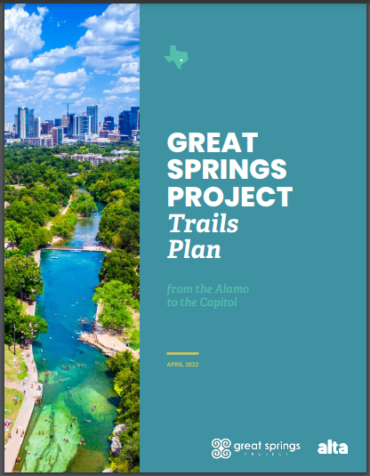

great springs
P R O J E C T
Trails Plan Released April 2022
Inspiring Leaders to Work Locally with a Regional Vision

Slide 18
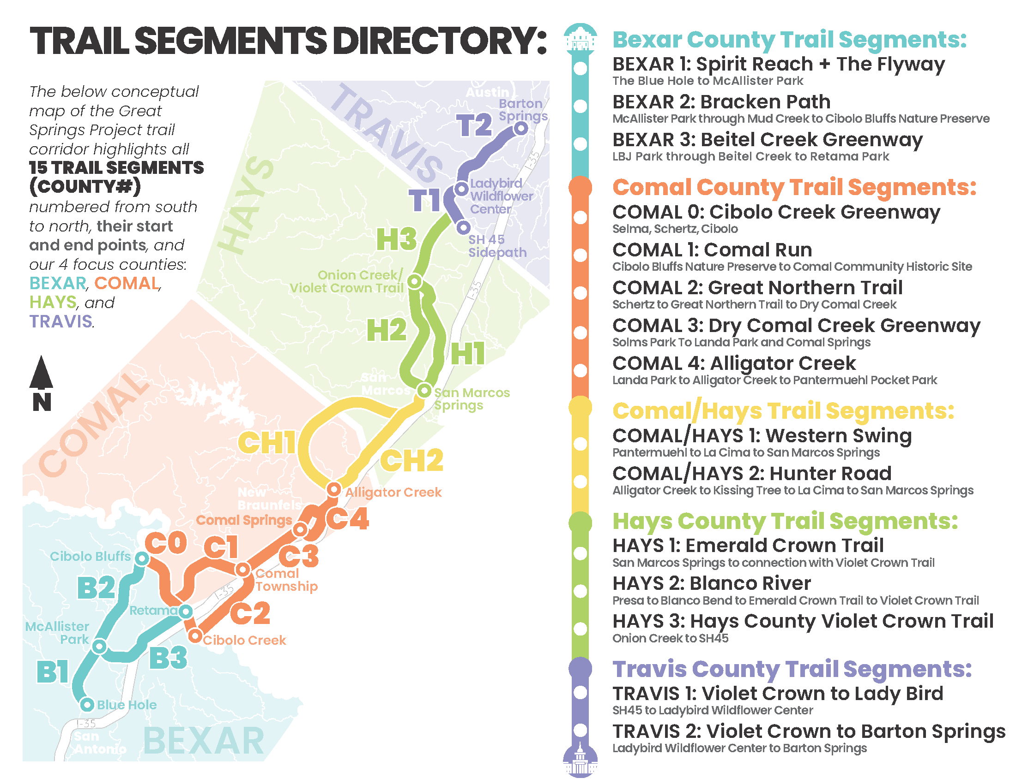
great springs
P R O J E C T
GSP Trail Segments

Slide 19
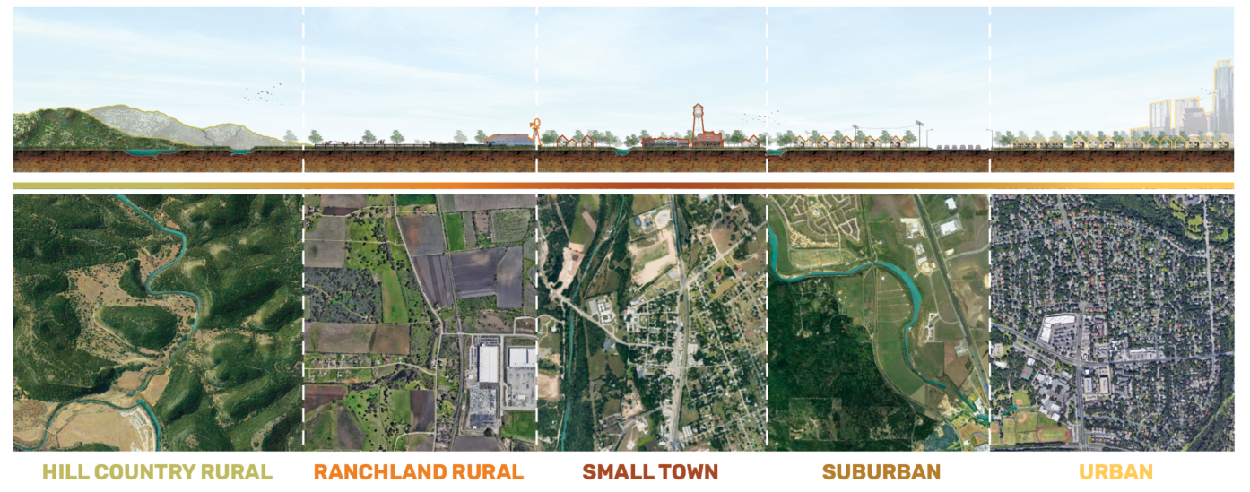
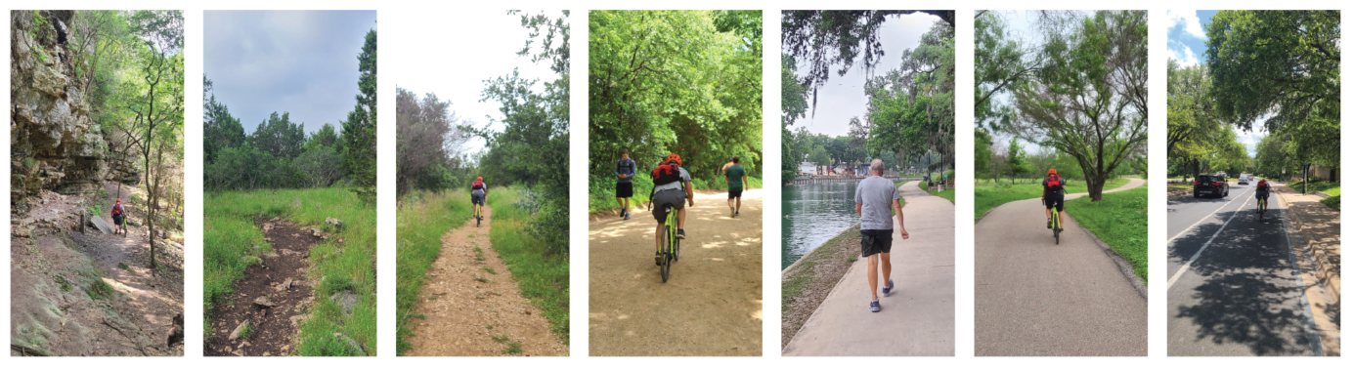
great springs
P R O J E C T
The trail may look different in these varying contexts.
Hiking Trails

Slide 20
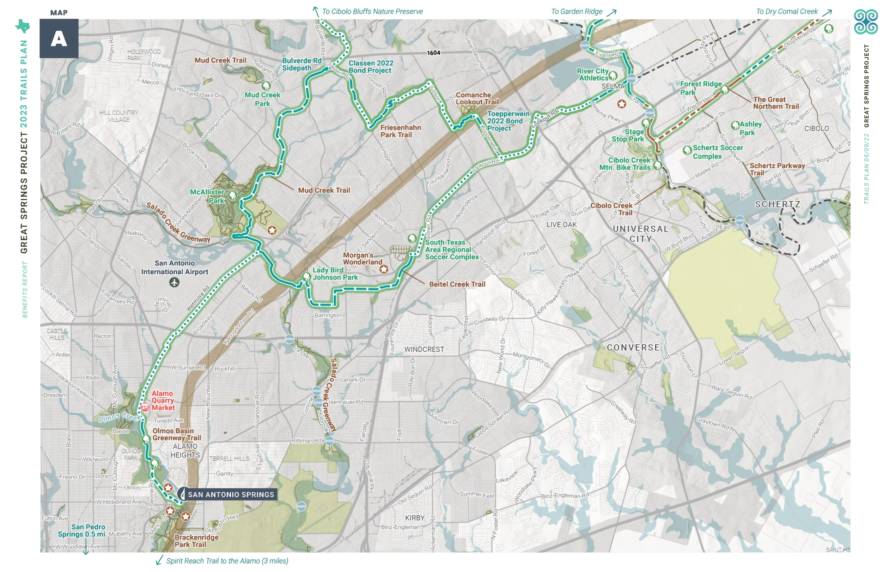
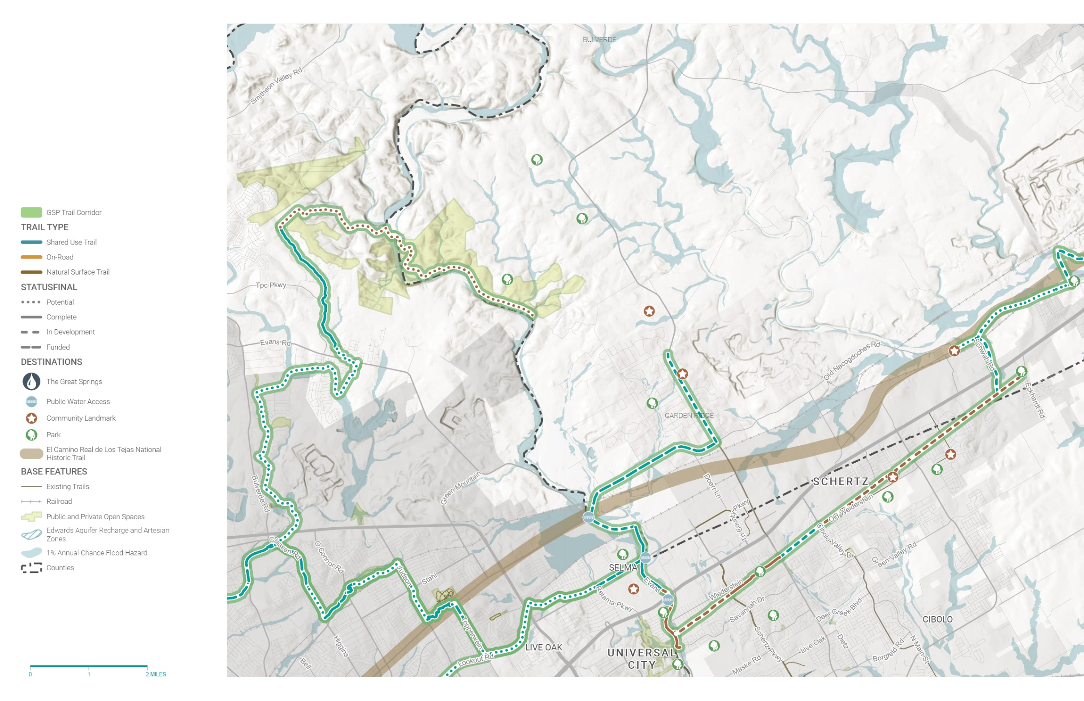
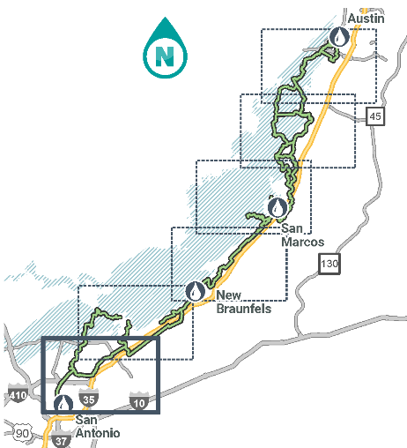
great springs
P R O J E C T

Slide 21
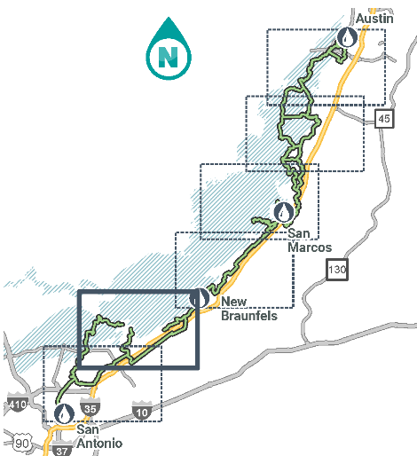
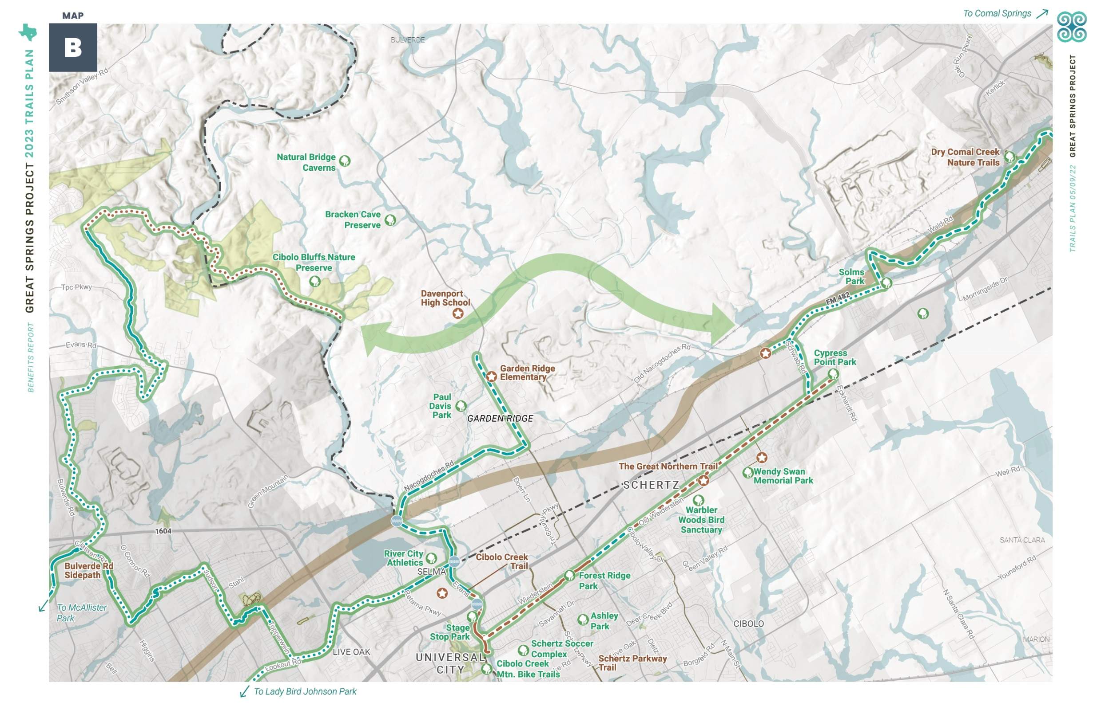
great springs
P R O J E C T

Slide 22
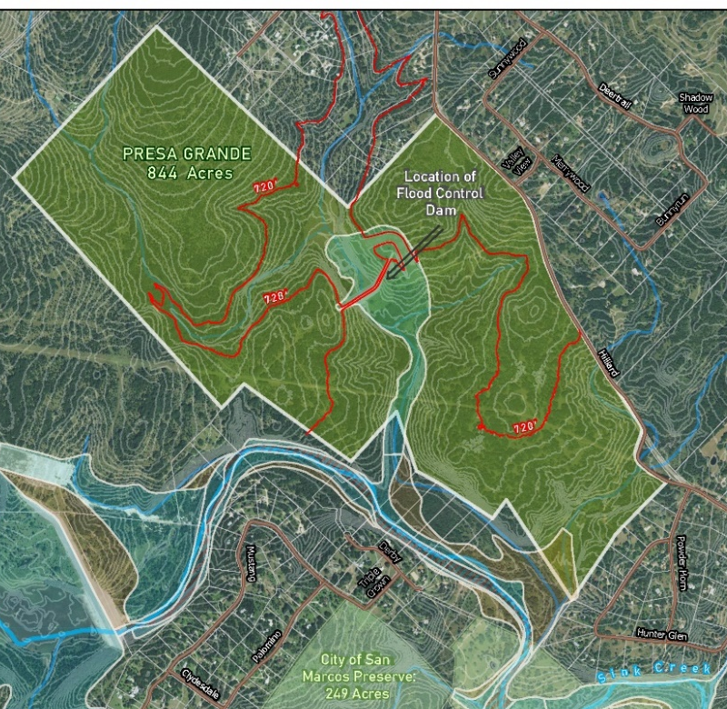
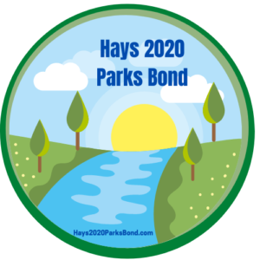
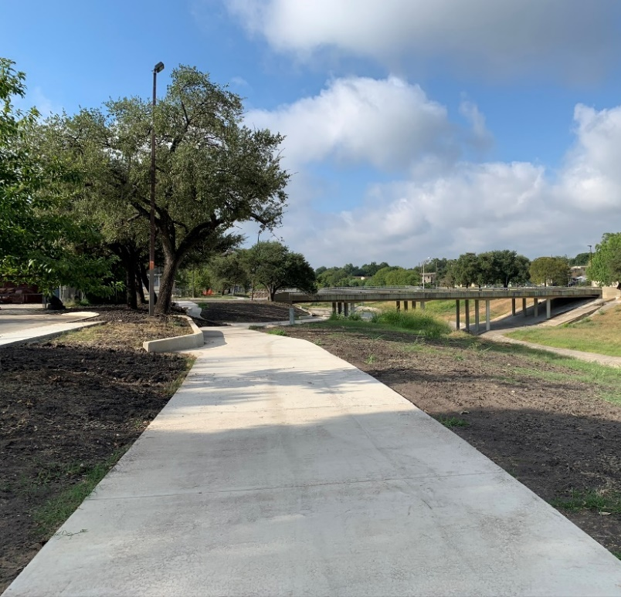
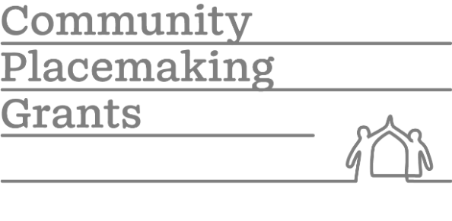
great springs
P R O J E C T
Leveraging Conservation & Public Space Opportunities
Conservation
Working with Hays County partners, Great Springs Project paired public dollars with private conservation buyers to finance the protection hundreds of acres of land and the creation of new trail connections.
Public Space Grants
In concert with the City of San Antonio’s completion of the West Side Creek Greenways, Great Springs Project submitted placemaking grants in partnership with the City to provide placemaking, safety interventions, and trail enhancements along the new greenway trails.

Slide 23
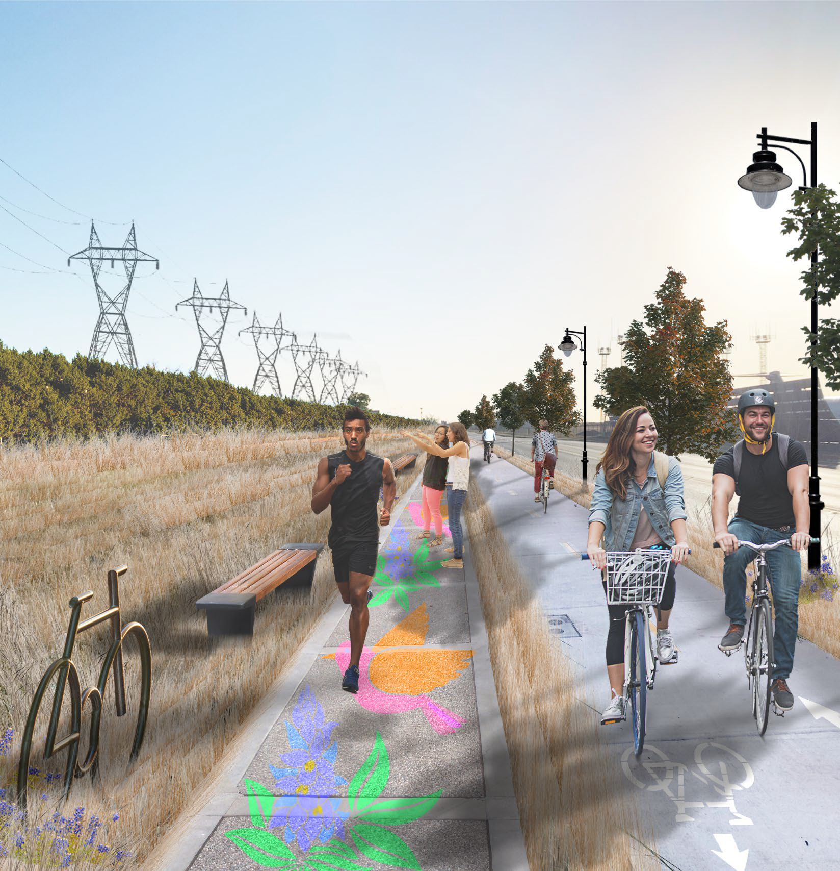
great springs
P R O J E C T
5’ for cycling and pedestrian amenities
5’-6’ for a pedestrian walkway with wayfinding
1’-2’ for a planted barrier
10’ for a painted cycle track
3’-5’ for lighting, shading, and planting
IT ONLY TAKES
25 FEET
TO MAKE A
PARK

Slide 24

great springs
P R O J E C T
TxDOT Roadway Design Manual (2022):
“6.4.4.2 Shared Use Paths Adjacent to Roadways (Sidepaths):
A minimum shy space of 2-ft should be provided to intermittent (e.g. signs, streetlights, utility poles) and continuous (e.g. walls, railings, fences, barriers) vertical objects to minimize crash risks and increase the comfort of path users.
Separate paths can be used which are physical separated from each other.
A separate bicycle facility type may be selected.”
THE DESIGNS ARE
APPROVED
NOW ITS TIME TO
IMPLEMENT

Slide 25
great springs
P R O J E C T
THANK YOU!
For more information on Great Springs Project,
including the Trails Plan,
Economic Benefits Report,
and to view an informational video,
please visit our website at www.greatspringsproject.org
Garry Merritt Kenny Skrobanek
CEO Trails & Transportation Planner
garry@greatspringsproject.org Kenny@greatspringsproject.org
(210) 260-9839 (512) 337-3850

